Slide 1
Azure SQL DB & DW
Sashank Pappu
Azure Data & AI Specialist

Slide 2

Insights is a journey
Insight
What happened?
Why did it happen?
What will happen?
What should I do?
Reports
Interactive
Dashboards
Predictive
Models
Recommendations
& Automation
Notes:
While data is pervasive, actionable intelligence from data is elusive. We understand that customers want to transform data to intelligent action and reinvent their business processes. To do this they need to more easily analyze massive amounts of data – so they can move from seeing “what happened” and understanding “why it happened” to predicting “what will happen” and ultimately, knowing “what should I do”. Only then can they create the intelligent enterprise and accelerate digital transformation.
Put another way, the journey to greater insight involves moving from “forensic” or “descriptive” analytics – use of historic measurement to describe what happened and why – to more advanced analytics that become “predictive” and eventually “prescriptive”.
This journey is a natural evolution as an organization leverages data more thoroughly. We think about it in 4 steps:
Step 1: What happened?
Utilize descriptive analytics to understand what happened
Step 2: Why did it happen?
Incorporate diagnostic analytics for a better understanding of why certain things happened in the past, making it possible to better identify root causes
Step 3: What will happen?
Expand into predictive analytics: With sufficiently detailed historical data and the rigorous application of statistical methods including machine learning, we can now predict a variety of events and effects that could not accurately be forecast in the past.
Step 4: What should I do?
Use prescriptive analytics for foresight: Foresight is the holy grail of analytics. By analyzing a set of reactions, we can not only predict what will happen, but how various responses will fare, given individual conditions, people, etc. It requires not only that we predict, but that we measure the individualized results of actions taken in the past, like medical treatments for particular patient cohorts, and then measure the effectiveness of past actions in prescribing how to react in the future. We can then automate action based on the prescriptive analytics, delivering business value directly in the flow of daily business activities.

Slide 3
Convergence accelerates digital transformation
Cloud
Data
Intelligence
Notes:
Three key trends are converging to accelerate digital transformation:
First, the cloud provides new and powerful ways to economically and reliably capture and persist the vast new data resources.
Second, thanks to the exponential proliferation of small, inexpensive chips and processors, computers are as ubiquitous as the people who use them. This is increasing the availability of vast and detailed data about products, businesses, market conditions, devices, and consumers and is creating new opportunities for businesses to tailor their strategy to market demand.
Finally, machines are everywhere, constantly creating, collecting and making sense of the data in our midst. With the magic of machine learning, along with the limitless computing power of the cloud, this data is giving rise to intelligence that is augmenting human capabilities in exciting new ways. This marks a unique point in history…an opportunity for organizations to automate and innovate quickly to increase their speed of business.

Slide 4
Time to adapt is shrinking
A hundred years ago, the average lifespan of a company listed on the S&P 500 index was 67 years
In the 2020s…
75% of the S&P 500 will be new (not on the index today)
25% of the S&P 500 will
be ones on the index today
Source: BBC
Notes:
Compared to the past, what’s unique about the disruption happening today is its pace. During past revolutions, firms had many years, even decades, to adapt. Today, that is no longer the case. One indicator of just how fast the landscape is changing is the longevity of companies on the S&P 500, an index of leading US companies.
A hundred years ago, the average lifespan of a company listed on the S&P 500 was 67 years. Today, that average lifespan has decreased to just 15 years.
Experts predict that in the next decade, only 25% of the companies currently listed on the S&P 500 will remain there, and the other 75% will be replaced by new companies.
The bottom line is, today’s organizations must adapt quickly to change, using new technologies that fuel competitive advantage, or risk getting left behind.
-------------------------------------------
Statistics source:
BBC, 2012, quoting Richard Foster - http://www.bbc.com/news/business-16611040
"The average lifespan of a company listed in the S&P 500 index of leading US companies has decreased by more than 50 years in the last century, from 67 years in the 1920s to just 15 years today, according to Professor Richard Foster from Yale University. Professor Foster estimates that by 2020, more than three-quarters of the S&P 500 will be companies that we have not heard of yet."

Slide 5
Data Ecosystem

Slide 6



Information Management
Information Management
Data Sources
Data Factory
Apps
Data Catalog
Event/IoT Hubs
Sensors and devices
Data
Notes:
T: Information Management includes Data Factory, Data Catalog, and Event Hubs.

Slide 7
Big Data Stores
Information Management
Big Data Stores
Data Sources
Data Factory
Data Lake Store
Data Catalog
SQL Data
Warehouse
Apps
Event Hubs
{ }
Cosmos DB
Sensors and devices
Data
Notes:
T: Azure provides a variety of storage options, including Blobs. Here we’ll dive into the two main storage options with Cortana Intelligence, starting with Data Lake Store.

Slide 8

Machine Learning and Analytics
Information Management
Big Data Stores
Machine Learning and Analytics
Data Sources
Data Factory
Data Lake Store
Machine Learning
Data Catalog
SQL Data
Warehouse
Data Lake Analytics
Apps
HDInsight
(Hadoop and Spark)
Event Hubs
{ }
Cosmos DB
Stream Analytics
Sensors and devices
Azure Analysis Services
Azure Time Series Insight
Data
Intelligence
Notes:
T: Advanced analytics services are where data starts turning into insight that drives intelligent action.

Slide 9
Intelligence
Information Management
Big Data Stores
Machine Learning and Analytics
Intelligence
Data Sources
Data Factory
Data Lake Store
Machine Learning
Cognitive Services
Data Catalog
SQL Data
Warehouse
Data Lake Analytics
Bot Service
Apps
HDInsight
(Hadoop and Spark)
Event Hubs
{ }
Cosmos DB
Cortana
Stream Analytics
Sensors and devices
Azure Analysis Services
Azure Time Series Insight
Data
Intelligence
Notes:
T: Our intelligence capabilities fall into three areas – Cognitive Services, Bot Framework and Cortana.

Slide 10

Transform data into intelligent action
Information Management
Big Data Stores
Machine Learning and Analytics
Intelligence
Data Sources
People
Data Factory
Data Lake Store
Machine Learning
Cognitive Services
Data Catalog
SQL Data
Warehouse
Data Lake Analytics
Bot Service
Apps
Web
Event Hubs
HDInsight
(Hadoop and Spark)
{ }
Cosmos DB
Cortana
Mobile
Apps
IoT Hubs
Stream Analytics
Dashboards & Visualizations
Bots
Sensors and devices
Azure Analysis Services
Azure Time Series Insight
Power BI
Automated Systems
Data
Intelligence
Action
Notes:
T: Cortana Intelligence provides everything you need to transform your organization’s data into intelligent action. Next, let’s take a look at another demo.

Slide 11


Build applications that understand people
Intelligence
Vision
Speech
Language
Knowledge
Search
Cognitive Services
Computer Vision
Speaker Recognition
Text Analytics
Academic
Bing Web Search API
Content Moderator
Bing Speech
Bing Spell Check
Entity Linking
Bing Image Search API
Bot Service
Face
Custom Speech Service
Web Language Model
Knowledge Exploration
Bing Video Search API
Cortana
Emotion
Linguistic Analysis
Recommendations
Bing News Search API
Video
Language Understanding
QnA Maker
Bing Auto Suggest API
Translator
Faces, images, emotion recognition and video intelligence
Spoken language processing, speaker recognition, custom speech recognition
Natural language processing, sentiment and topics analysis, spelling errors
Complex tasks processing, knowledge exploration, intelligent recommendations
Bing engine capabilities for Web, Autosuggest, Image, Video and News
Notes:
What’s incredibly unique is the intelligence capabilities Cortana Intelligence offers, building on years of Microsoft research and innovation. These capabilities enable our customers to build intelligent systems and agents that can augment their organizational capabilities. For example, organizations can interact with customers and stakeholders in new ways and infer intent with vision, face, speech, text and sentiment analysis to customize responses and drive appropriate actions.
Microsoft Cognitive Services, a set of cloud services, APIs and SDKs that enable organizations to build intelligent systems that can see, hear, interpret and understand the world around you and makes all applications more intelligent, engaging and discoverable. Cognitive Services expands the existing perceptual intelligence capabilities like Vision, Speech, Text and Face detection to include new cognitive capabilities such as Emotion and customized Language Understanding. What we showcased with www.how-old.net is one example of what is possible.
T: Next, Bot Service.

Slide 12











Your bots – wherever your users converse
Intelligence
Accelerate development cycles
Enrich your bots
Boost operational efficiencies
</>
Cognitive Services
Bot Service
Develop your way
Built in code editor
Channel support
Cognitive Services
Powered by Azure Functions
Continuous deployment
Cortana
Quick start templates
Integrated chat window
Direct Line support
Embedded web chat
Scale on demand
Reduced dev ops
Start quickly with built-in templates
Reach your customers on multiple channels
Boost the power of bots with Azure services
No server management or patching needed
Scale out automatically
Pay only for what you use
Notes:
Azure Bot Service enables rapid intelligent bot development, bringing together the power of the Microsoft Bot Framework and Azure Functions. Build, connect, deploy and manage intelligent bots that interact naturally wherever your users are talking – from your app or website to text/sms to Skype, Slack, Facebook Messenger, Kik, Office 365 mail, Teams and other popular services. Allow your bots to scale based on-demand and you pay only for the resources you consume.
T: Next, Cortana.

Slide 13
Microsoft SQL Platform Continuum
Hybrid Cloud
Shared Lower Cost
On Premises
Platform as a Service
SQL
SQL
SQL
Azure SQL Database Virtualized Databases
Infrastructure as a Service
SQL
SQL
SQL
SQL Server in Azure VM Virtualized Machines
Virtual
SQL
SQL
SQL
SQL Server Private Cloud Virtualized Machines + Appliances
Physical
SQL
SQL Server Physical Machines (raw iron)
Dedicated Higher Cost
Off Premises
Higher Administration
Lower Administration

Slide 14
Azure SQL Database
Relational database-as-a-service, fully managed by Microsoft
For cloud-designed apps when enterprise-grade features and near-zero administration are key
Elastic Scale and Performance
Business Continuity and Data Protection
Self-managed and Familiar
Predictable performance levels
Scale up/down & out/in
Dashboard views of DB metrics
Self-service restore
Disaster recovery
Compliance-enabled
Self-managed
Programmatic APIs
Familiar tools and language
Enterprise-grade database platform with cloud economics

Slide 15
Azure SQL Database Service Tiers
Basic
Standard
Premium
Intended Use
Light transactional loads
Go-to option for most business applications
High throughput and business-critical databases
Availability
99.99%*
Size
2 GB
250 GB
500 GB
Performance
•
••
•••
Business Continuity
•
••
•••
Incremental performance and features with easy upgrade and downgrade
*The 99.99% availability SLA does not apply to Web and Business editions, which continue to be supported at 99.9% availability.

Slide 16
Azure SQL Database
Elastic Scale and Performance
Business Continuity and Data Protection
Self-managed and Familiar
Predictable performance levels
Scale up/down & out/in
Dashboard views of DB metrics
Self-service restore
Disaster recovery
Compliance-enabled
Self-managed
Programmatic APIs
Familiar tools and language

Slide 17
Scalable Performance
Basic, Standard, and Premium provide increasing performance levels
Relative performance is expressed in database throughput units (DTUs)
DTU is a blended measure of CPU, read IO, write IO, and memory
Scale performance up/down via portal, APIs, PS, or T-SQL to reflect actual or anticipated demand
Database remains online while scaling
Hourly billing improves cost efficiency
P3
P2
P1
S2
S0
S1
B
DTUs
5
10
20
50
100
200
800
Performance is easily scaled up or down to meet changing workload and business needs

Slide 18
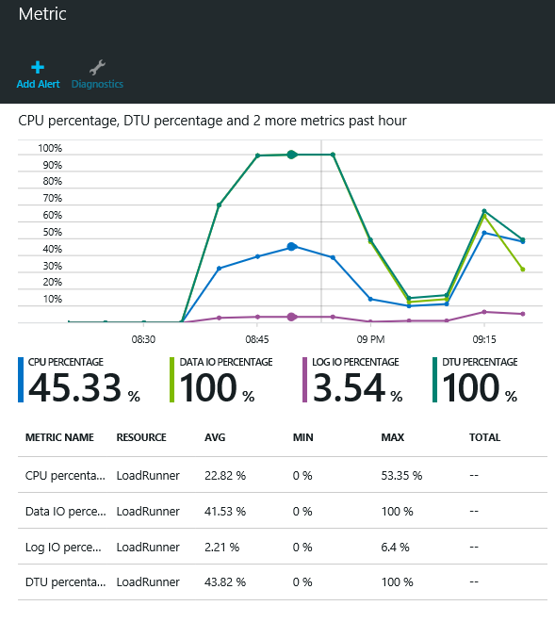
Rich Near-real-time Monitoring
Monitor resource consumption over time and set user-configurable alerts and notifications to guide scaling decisions
Rich metrics include % DTU usage, resource usage, database size, connection health
Dashboard views in the portal, or via APIs and DMVs
In-depth DMVs aid troubleshooting (e.g. at the query level)
Use monitoring and alerts to understand and manage resource utilization

Slide 19
Azure Database Migration Journey
Assess
Migrate
Optimize
https://datamigration.microsoft.com/

Slide 20
Azure Database Migration

Slide 21
Azure Storage Accounts

Slide 22
Azure Storage Components:
Blobs – Highly scalable, REST based cloud object store
Tables – Massive auto-scaling, NoSQL store
Queues – Reliable messaging at scale for cloud services
Disks – Persistent Premium & Standard disks for Azure IaaS VMs
Files – SMB 3.0 access to Azure Storage
Azure Import/Export – Ship data in HDD
AZCopy – High-performance data upload , download, & copy

Slide 23
Durability Options
Locally Redundant Storage (LRS)
Stores 3 replicas of the data within a single zone (facility) in a single region
Provides data durability for disk, node and rack failures
Geo Redundant Storage (GRS)
Stores 6 replicas of the data across two regions (3 in each region)
Provides additional durability to protect data against major regional natural disasters (e.g., tornado, hurricane, fire, etc, destroying a whole region)
Updates across regions are performed asynchronously
Zone Redundant Storage (ZRS)
Stores 3 replicas of the data across multiple zones (facilities) within a single region or across regions
Provides additional durability to protect data against zone failures (e.g., fire burning down a facility)

Slide 24
Access Control
Symmetric Shared Key AuthN
Trusted service that owns the storage accounts
Shared Access Signature (SAS) Delegated AuthZ
3rd party services
Mobile device applications
Restricted access for services
Allow client applications to directly communicate with Storage rather than scaling a proxy web service
Public (Blob service only)
CDN access
Browser based access

Slide 25
Azure SQL DW

Slide 26
INTRODUCTION
The Case for Cloud Date Warehousing
Exploring Azure SQL Data Warehouse
MPP Concepts
Exploring SQL DW Components

Slide 27
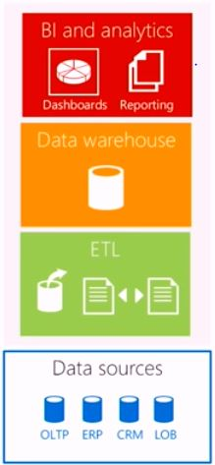
THE TRADITIONAL DATA WAREHOUSE
The single source of truth or the central repository for all the data in the company

Slide 28
What would it take to build my own DB?
HARDWARE
5 Enterprise class servers or VM’s
Sufficient RAID enabled disk or SSD
Hardware load balancing
Power/Cooling/Rackspace
Network capable of geo-replication
Secure Facility
SOFTWARE
Server software License
DB software license
Maintenance costs
Systems management software
Configuration management tools
Billing software
Backup tools
PERSONNEL
DBA
System Admin OS expert
Networking specialist
Storage manager
Operation staff
Technical management

Slide 29

Data warehouse fairytale
Once upon a time, data warehouse was an appliance who required fixed combinations of storage and compute, often underutilizing expensive resources. Meaning monstrous hardware was lying unused.

Slide 30
What is Azure SQL Data warehouse
Cloud– Azure PaaS
Distributed Database– an MPP
Processing Massive Volumes– up to PBs
SQL Capabilities– a relational DB that can
Grow ,Shrink & Pause - use what you need, when you need it..

Slide 31
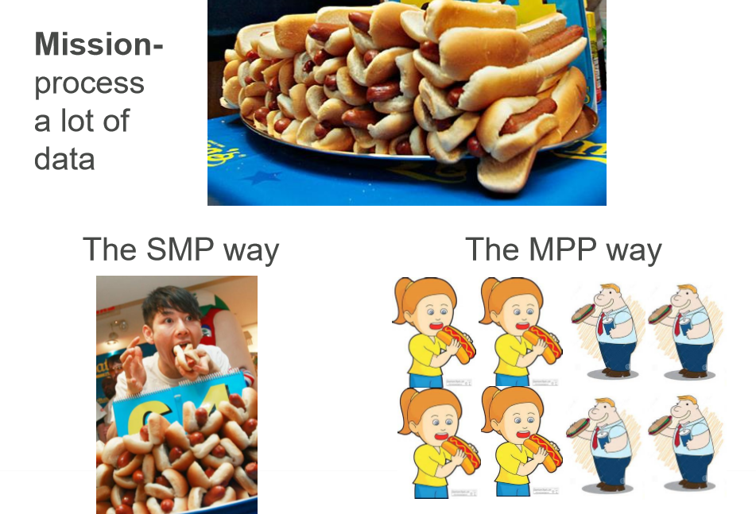

Slide 32
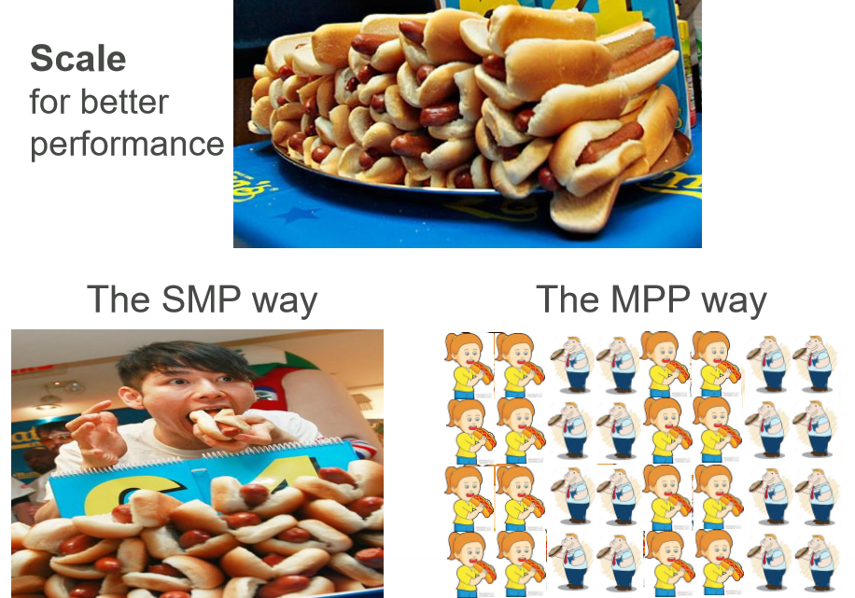

Slide 33
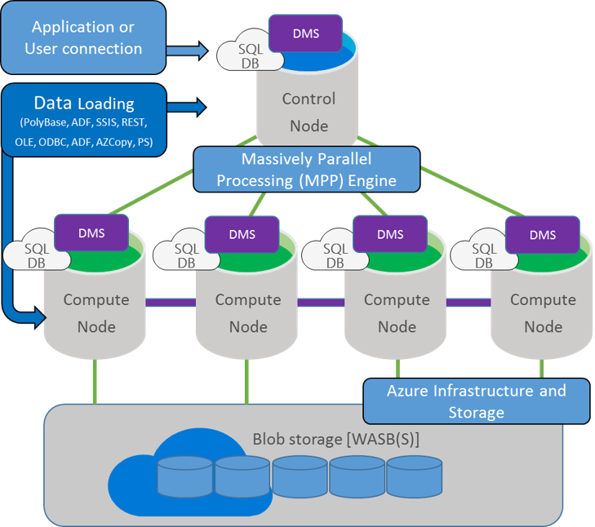

Slide 34
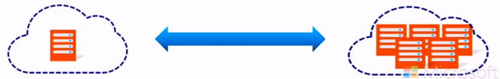
Rapidly deploy and gain insights
Spin up for heavy workloads, cycle down for daily activity .
Buy time to insight based on what you need, when you need
Choose the combo of compute and storage that meets your
needs.
Resize in
< 1 Minute
From Any Size to
Any Size
On-Demand
Compute

Slide 35

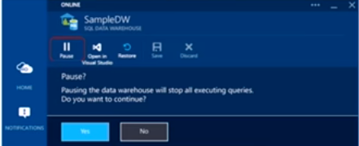
When Paused, Pay only for Storage
Use it only when you need it — no reloading / restoring
Save Costs with Dynamic Pause and Resume
When paused, cloud-scale storage is min cost.
Policy-based (i.e. Nights/weekends)
Automate via PowerShell/REST API
Data remains in place

Slide 36
Data Warehouse Units
Introducing DWUs
Data Warehouse Units
Abstraction of underlying resources
-CPU
- Memory
- IOPS
• A measure of metrics
- Scan/Aggregation, Load, CT AS
• Scale your SQL DW by changing DWI-Js
- On-the-fly

Slide 37
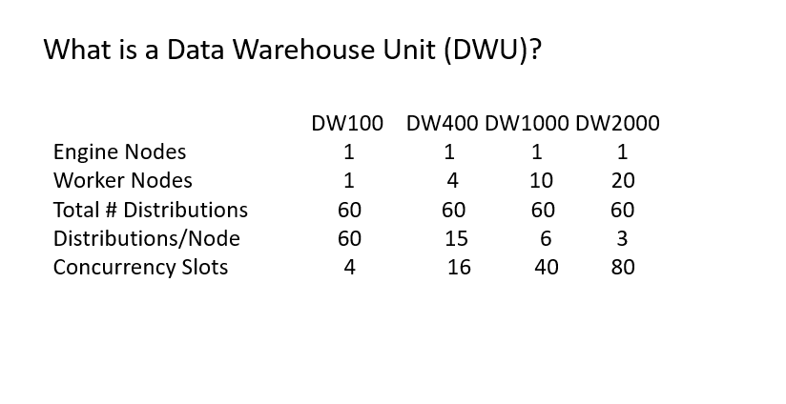
What is a Data Warehouse Unit (DWU)?

Slide 38
Architecture for DW100
Azure Storage Blob(s)
Azure SQL Data Warehouse
D1
D2
D3
D4
D5
D6
D7
D1
D9
D10
D8
D11
D12
D13
D14
D15
D16
D17
D18
D19
D20
D21
D22
D23
D24
D25
D26
D27
D28
D29
D30
Engine
Worker 1
D31
D32
D33
D34
D35
D36
D37
D38
D39
D40
D41
D42
D43
D44
D45
D46
D47
D48
D49
D50
D51
D52
D53
D54
D55
D56
D57
D58
D59
D60

Slide 39
Architecture for DW600
Azure Storage Blob(s)
Azure SQL Data Warehouse
Worker 1
D1
D2
D3
D4
D5
D6
D7
D1
D9
D10
D8
Worker 2
D11
D12
D13
D14
D15
D16
D17
D18
D19
D20
Engine
Worker 3
D21
D22
D23
D24
D25
D26
D27
D28
D29
D30
Worker 4
D31
D32
D33
D34
D35
D36
D37
D38
D39
D40
Worker 5
D41
D42
D43
D44
D45
D46
D47
D48
D49
D50
Worker 6
D51
D52
D53
D54
D55
D56
D57
D58
D59
D60

Slide 40
PROVISIONING A SQL DATA WAREHOUSE

Slide 41
INTRODUCTION
Preparing to Deploy SQL DW
Provisioning SQL DW from Portal.
Querying SQL DW
Provisioning SQL DW with Power Shell
Provisioning SQL DW with T-SQL

Slide 42
PREPARING TO DEPLOY SQL DW
Deployment considerations
Azure subscription : Where will the deployment be billed? Account access
Resource group : New or existing?
Logical server : New or existing?
Database name : Must be unique to its server
Performance settings : Start with 400 DWU, adjust later
Security Authentication : server administrator, firewall rules

Slide 43
Deployment methods
Azure Portal (server & database)
Browser
PowerSheII (server & database)
Needs Azure PowerShell module
T-SQL (database only)
Visual Studio 2013(or later) with SSDT
SQL Server Management Studio, sqlcmd

Slide 44
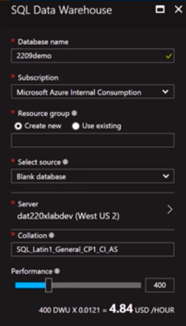
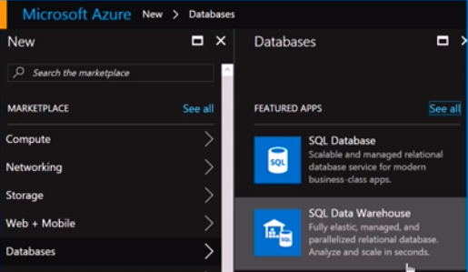
Provisioning : Azure Portal

Slide 45
Provisioning : PowerShell
Login- AzureRmAccount …
Get- AzureRmSubscription …
New-AzureRmSqlDatabase
-RequestedServiceObjectiveName “DW400”
-DatabaseName "DAT200Demo "
-ServerName "DAT200Svr"
-ResourceGroupName " DAT200RG"
-Edition "DataWarehouse"

Slide 46
Provisioning : T-SQL
CREATE DATABASE DAT200Demo
COLLATE SQL_Latin1_General_CP1_AS
(EDITION=‘datawarehouse‘,SERVICE_OBJECTIVE = ‘DW400’
MAXSIZE= 10240 GB) ;
Create logical server in Portal or with PowerShell

Slide 47
DESIGNING TABLES AND
LOADING DATA

Slide 48
INTRODUCTION
Distributing Data
Designing Tables
Loading Data
Indexes and Statistics
Lab: Designing Tables and Loading Data

Slide 49
Partitioning tables in SQL Data Warehouse
Benefits of partitioning : Works upon the ADW Distribution .
Benefits to loads
Benefits to queries : Applied to Filtered Partitions.
WITH (
CLUSTERED COLUMNSTORE INDEX , DISTRIBUTION = HASH([ProductKey]) ,
PARTITION ( [OrderDateKey] RANGE RIGHT FOR VALUES
(20000101,20010101,20020101 ,20030101,20040101,20050101 ) )
)

Slide 50
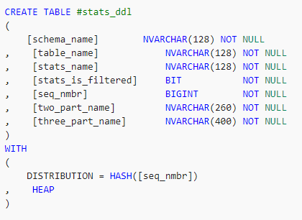
Temporary tables in SQL Data Warehouse
Best for transformation where the intermediate results are transient
Temporary tables offer a performance benefit because their results are written to local rather than remote storage . But global tables are not available yet.
Temporary tables are slightly different in Azure SQL Data Warehouse than Azure SQL Database as they can be accessed from anywhere inside the session, including both inside and outside of a stored procedure.
Create a temporary table

Slide 51
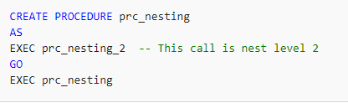
Stored procedures in SQL Data Warehouse
Limitations and Usage :
SQL Data Warehouse support a maximum of 8 nesting levels.
Temporary stored procedure
Encryption option

Slide 52
DESIGNING TABLES
Data Distribution Concepts
Defined:
"The process of distributing or spreading out ... "

Slide 53
Why Distribute Data
Divide & conquer: lots of small queries to solve
Evenly spreading the data can lead to balanced
use of the appliance resources

Slide 54


Distributed Data = 60 Buckets of Water

Slide 55
MPP SQL Table Geometries
Distributed:
A table structure that is distributed across all MPP nodes of the Data Warehouse Database
HASH : where the value of a single column gets hashed to define the distribution
number where the records will get inserted
ROUND_ROBIN: where the records are distributed in a "round robin" manner
across all distributions

Slide 56
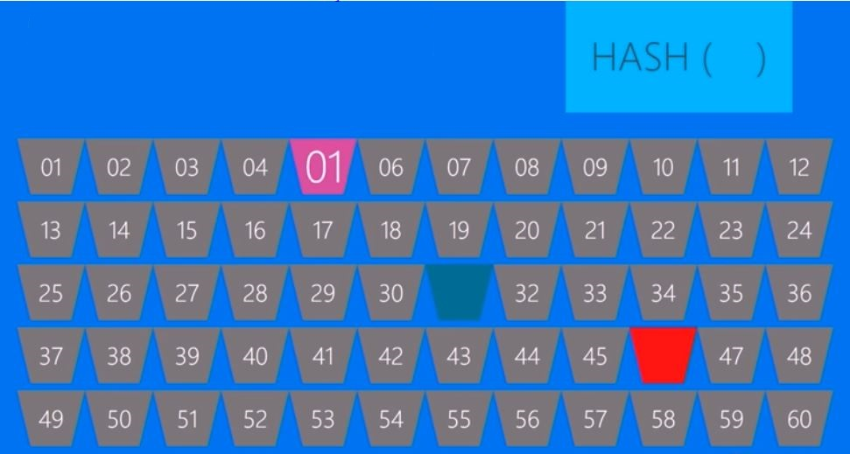
HASH DISTRIBUTION

Slide 57
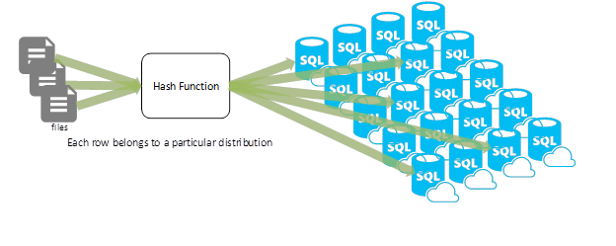
Hash Distribution

Slide 58
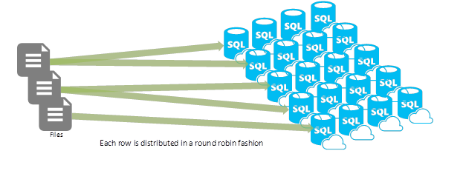
Round Robin

Slide 59
To HASH or ROUND ROBIN?
Use HASH distributed tables when:
• For fact/detail tables if you DO have a common distribution key which is used in multi-distributed table joins
• If Full Table Scans do not provide acceptable performance
Use ROUND ROBIN distributed tables when:
• Multiple "primary/foreign key"-like joins are common
• When the data is an initial loading table

Slide 60
INDEXES AND STATISTICS
What are Statistics?
Contain statistical information about the distribution of values in a column
The statistics object includes a histogram to show the distribution of values in the
first column
Multi-column statistics can also be generated
These also hold density information i.e. the correlation of values between columns

Slide 61
Statistics
Statistics on compute nodes
SQL DW uses automatic statistics settings on compute nodes
Compute node statistics use standard SQL Server sampling
Updated after table changes by 20 percent
Can use compound (covering) statistics
Statistics on control node
SQL DW uses statistics on control node to improve performance by using cardinal estimation
Not updated automatically!

Slide 62
Best Practices : Statistics
Background
Two levels of statistics exists in the SQL DW Engine
SQL level — on Compute Nodes — maintained automatically
MPP level — cumulative statistics on Control Node's Shell DB for cost based optimization
MPP level statistics is not maintained/created automatically
Goal
Updated statistics for best cost based optimization

Slide 63
Best Practices : Statistics
Solution - Two options
1. Create statistics for all columns used in JOINS, GROUP BY, WHERE
• Smart approach, but may not be feasible in all scenarios
2. Create statistics for all columns and all tables
• Easy, but implies overhead

Slide 64
BIG DATA INTEGRATION
AND
SQL DW MANAGEMENT

Slide 65
INTRODUCTION
Integrating SQL DW in a Big Data Solution
Importing and Querying with PolyBase
Managing and Securing SQL DW
Protecting and Recovering Data
Demo: Integrating SQL DW in a Big Data Solution

Slide 66
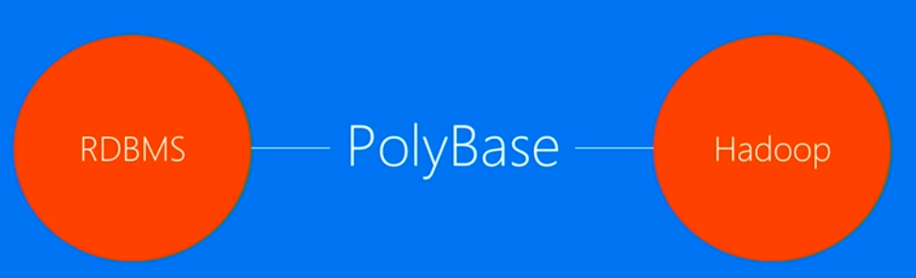
POLYBASE
Big Picture
Provides a scalable, T-SQL compatible query processing
framework for combining data from both universes

Slide 67
Why use PolyBase?
Query data stored in Hadoop from SQL Server or ADW.
Query data stored in Azure Blob Storage
Import data from Hadoop, Azure Blob Storage, or Azure Data Lake Store
Export data to Hadoop, Azure Blob Storage, or Azure Data Lake Store.
Push computation to Hadoop

Slide 68
Poly Base Use Cases
Load Data
Use Hadoop as an
ETL tool to cleanse
data before loading
to data warehouse
with PolyBase
Interactively Query
Analyse relational
data with semi-
structured data using
split-based query
processing
Age-out Data
Age-out data to
HDFS and use it as
'cold' but query-able
storage

Slide 69

Query
Results
SELECT TOP 10 *
FROM SQL SERVER S
JOIN Hadoop H
S.Key = H.Key
JOIN Blob B
and S.Key = B.Key
SQL DW
W/ PolyBase
Hadoop
Azure Blob
Storage

Slide 70
SECURING AND PROTECTING DATA

Slide 71
Who manages what?
ON PREMISES INFRASTRUCTURE PLATFORM SOFTWARE
Physical/Virtual as a Service as a Service as a Service
Applications
Applications
Applications
Applications
Data
Data
You manage
Data
Data
You scale, make
resilient and manage
Runtime
Runtime
Runtime
Runtime
Middleware
Middleware
Middleware
Middleware
You scale, make resilient and manage
Scale,Resilience and Management by Microsoft
O/S
O/S
O/S
O/S
Virtualization
Virtualization
Virtualization
Virtualization
Scale, Resilience and Management by Microsoft
Servers
Servers
Servers
Servers
Managed by Microsoft
Storage
Storage
Storage
Storage
Networking
Networking
Networking
Networking
Windows Azure Virtual Machines
Windows Azure Virtual Machines

Slide 72
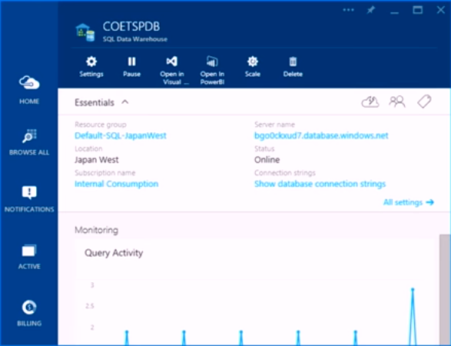
Managing a Azure SQL DW database
Monitor
Pause/Resume
Scale
Delete
Open with Visual
studio/PowerBI

Slide 73
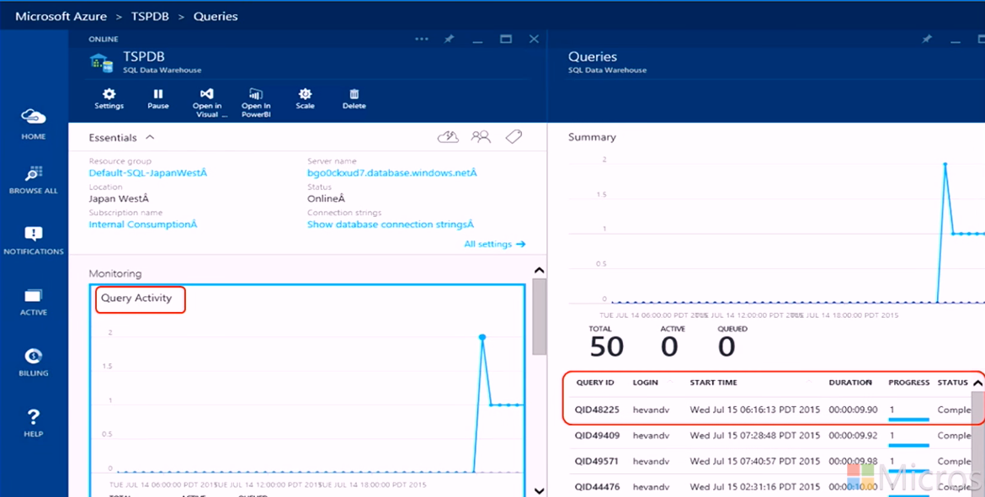
Monitoring – Query Activity

Slide 74
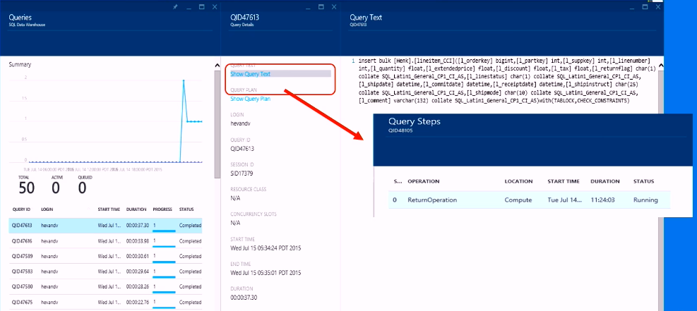
Monitoring – Query Activity

Slide 75
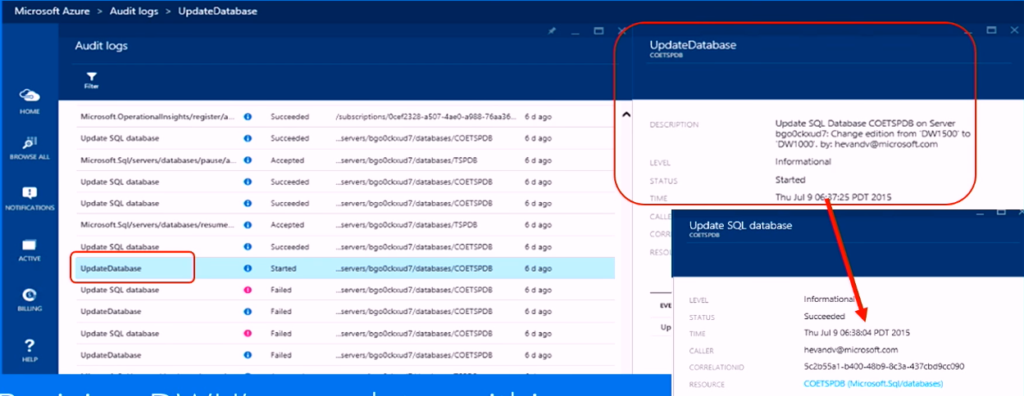
Notification log
Resizing DWU’s completes within seconds

Slide 76
Security
Connection
Authentication
Authorization
Encryption
Auditing
Threat Detection

